Slide 1
Smart Cities Internet of Things challenge

Slide 2
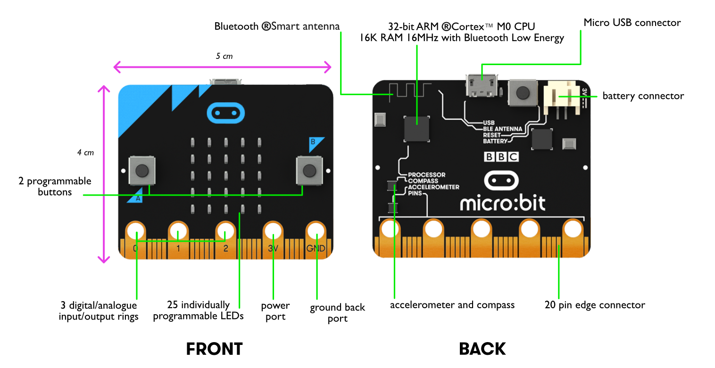
The micro:bit v1
Notes:
Introduce the micro:bit as the platform we will be using
Explain the features and functionality

Slide 3
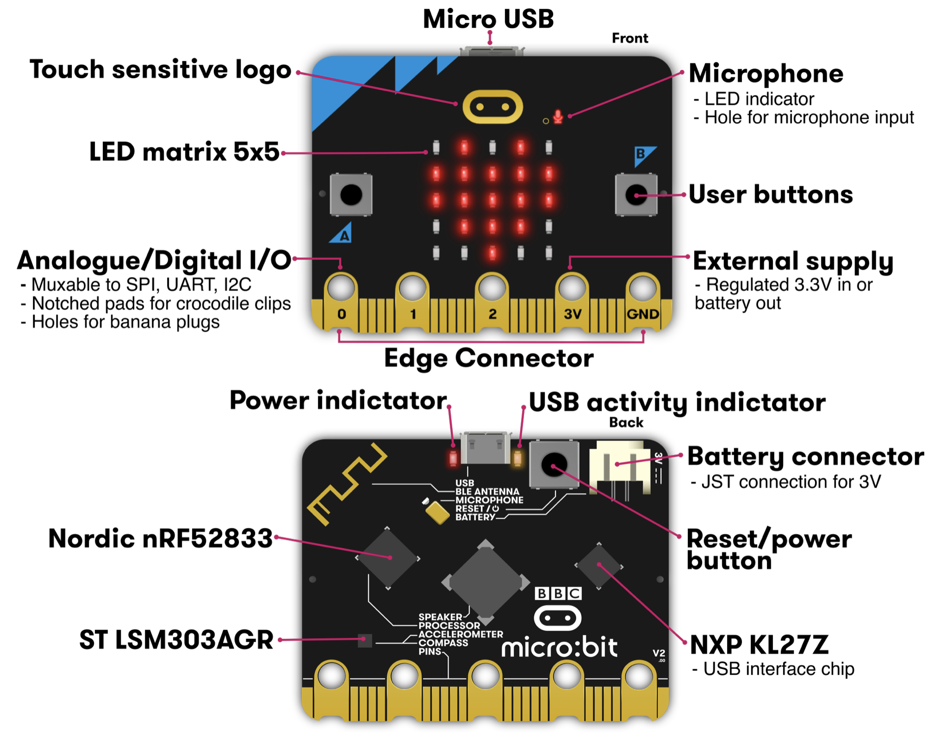
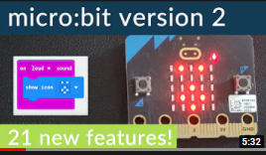
The micro:bit v2
Speaker
Microphone
Faster
More memory
Extra button on logo
Notes:
Introduce the micro:bit as the platform we will be using
Explain the features and functionality

Slide 4
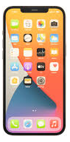
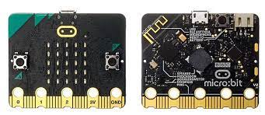
Useful comparison
Micro:bit
Smartphone
Buttons
Capacitive touch (logo)
Screen (LEDs)
Bluetooth
Speaker
Microphone
Other sensors
USB
Buttons
Capacitive touch screen
Screen (LEDs)
Bluetooth
Speaker
Microphone
Other sensors
USB

Slide 5
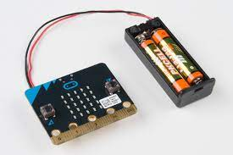
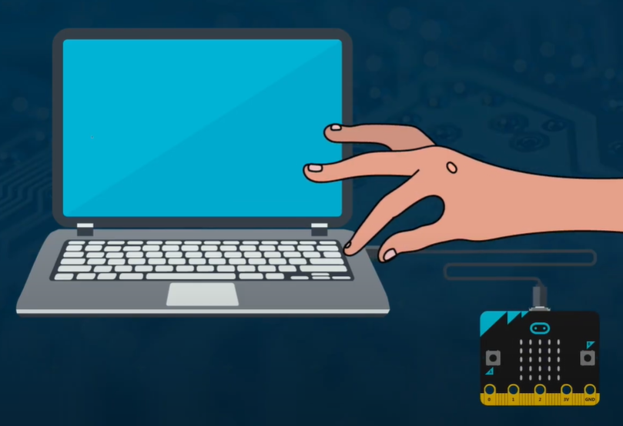
Practical point
The micro:bit needs power from somewhere
Battery pack
Power from USB
Notes:
Discuss limitations of each approach.
USB tethers to PC – cable length issues, access to USB ports etc.
Battery gives more freedom but batteries run out!

Slide 6
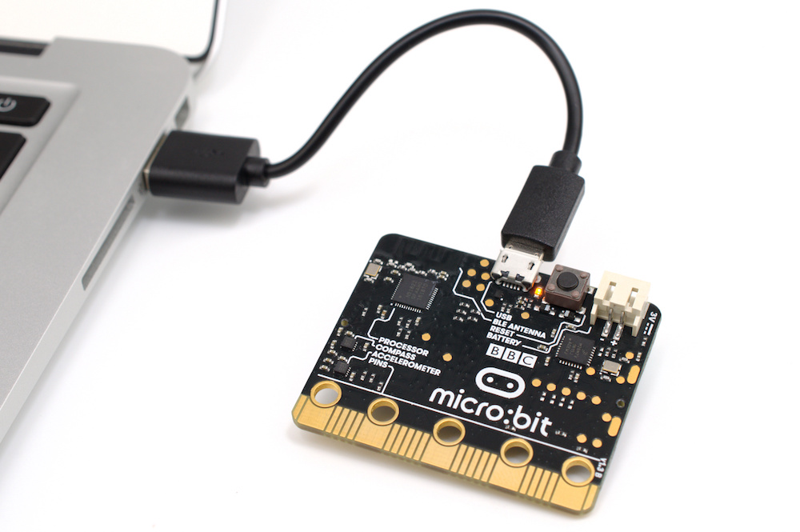
Make a program on Makecode
Download the .hex to the PC
Transfer the .hex to the micro:bit

Slide 7
Kit
You will need for the street light:
2 x micro:bits
1 x scroll:bit
1x sense:bit
Building materials
card
scissors
pens
etc.
Stretch tasks:
These involve additional hardware that can be got from the judges
The main light must be complete first!

Slide 8
How your teams will be judged
Originality/creativity of the idea/solution
Teamwork
Elevator pitch
Quality of design adaptation
Build quality of the prototype
Marketing
Bonus points for stretch tasks!

Slide 9
Design adaptation
Your designs will need updating as you build and improve your product
Add material choices to the design for the prototype and final product
Update them as you go and explain your choices!

Slide 10
Elevator pitch
briefly explain the benefits of your design ideas to the judge
~2 mins
The judge may have additional questions!

Slide 11
Marketing
You need to develop some marketing material to advertise your product to other cities/countries. You must use appropriate software for the task.
You need to create:
a logo (digital)
A 1 page website (a mock-up will do if the tools are not available)
A marketing flyer (A5)

Slide 12
Success criteria for the build
The street light must:
be 30cm tall
minimise light pollution (scroll:bit)
be robust
use the available sensors (sense:bit)
be smart (use other micro:bits for this!)

